Slide 1
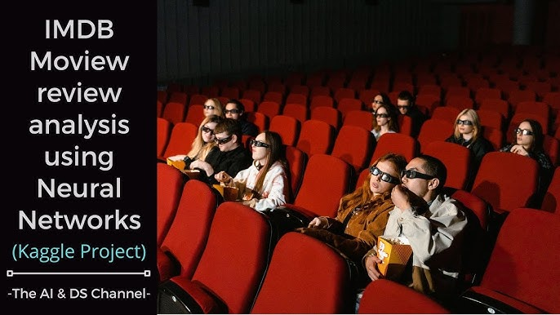
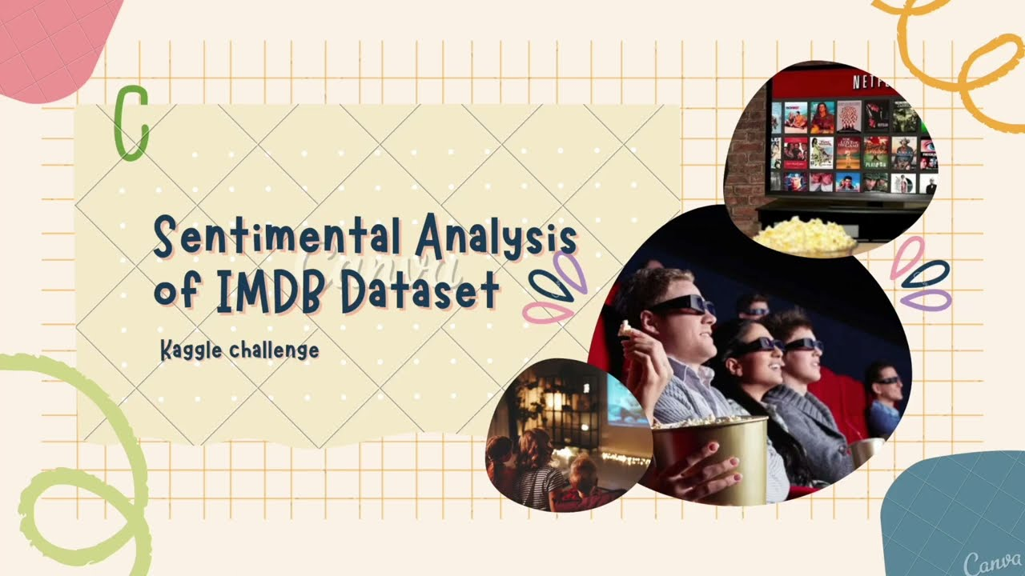

Slide 2

Number | Name
1 | Rana Yasser Anter
2 | Youssef Mohamed
3 | Youssef Magdy
4 | Ahmed Rabie
5 | Youssef Tarek
6 | Hazem Mohamed

Slide 3
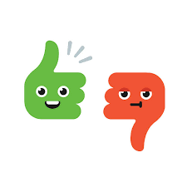
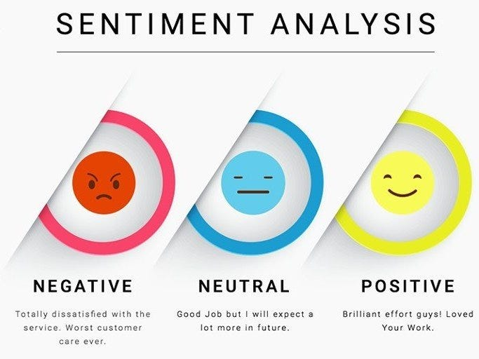
✨ Introduction ✨
This project is about Sentiment Analysis 🧠💬 of movie reviews 🎬⭐ from the IMDB dataset.
The goal is to automatically classify each review as Positive 😊 or Negative 😞.
🔹 Why Sentiment Analysis?
Helps businesses understand customer opinions 💡
Improves decision-making in marketing 📊
Supports the film industry 🎥
In this project, we:
✅ Collected and preprocessed text data 📝
✅ Applied Natural Language Processing (NLP) 🔤
✅ Built and trained a Deep Learning model 🤖
✅ Achieved high accuracy in classifying reviews 🎯

Slide 4

🚨 Problem & Solution 💡 🛑 Problem: Thousands of reviews are written daily on IMDB 🎬💬 Manual reading is time-consuming ⏳ Judgments can be biased 👀 Hard to know if feedback is positive 😊 or negative 😞 ✅ Solution: AI-powered Sentiment Analysis 🤖 Automatically reads & classifies reviews 📝 Detects Positive 😊 or Negative 😡 opinions Provides fast, accurate, and objective results 🎯 Helps decision makers understand audience better 📊

Slide 5
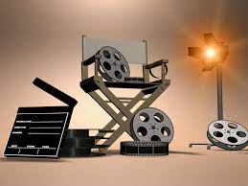
🎯 Project Objectives
1️⃣ Develop an intelligent model 🤖 to analyze movie reviews from IMDB.
2️⃣ Classify reviews 📝 into two categories: Positive 😊 or Negative 😡.
3️⃣ Save time ⏳ compared to manual review analysis.
4️⃣ Ensure fairness ⚖️ by reducing human bias in evaluation.
5️⃣ Support decision-makers 📊 with accurate insights about audience opinions.
6️⃣ Enhance user experience 🌐 by providing fast and clear sentiment results.

Slide 6

🟦 Dataset Description 1️⃣ Source 🌐: Kaggle – IMDB Movie Reviews Sentiment Analysis Dataset. 2️⃣ Content 📝: Collection of movie reviews written by real users. 3️⃣ Labels 🔖: Each review is labeled as either: Positive 😊 Negative 😡 4️⃣ Size 📊: 50,000 reviews in total. 25,000 reviews for training. 25,000 reviews for testing. 5️⃣ Format 📄: Text-based dataset (plain English sentences). 6️⃣ Purpose 🎯: Used for sentiment analysis to classify emotions and opinions in text.

Slide 7
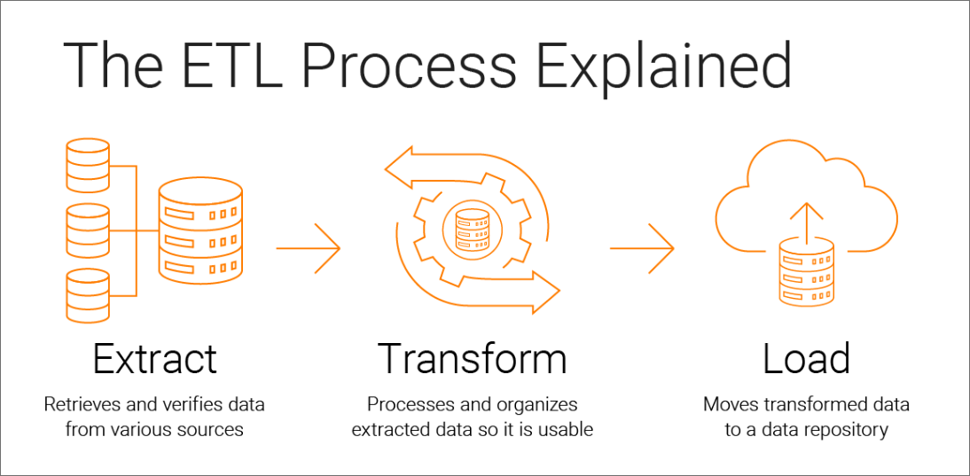
Methodology / Approach 🛠️ Data Preprocessing 🔄 Cleaning dataset (removing nulls, duplicates). Text normalization (lowercasing, removing stopwords, punctuation). Text Representation ✍️ TF-IDF (Term Frequency – Inverse Document Frequency). Word Embeddings (Word2Vec / GloVe). Algorithms Applied 🤖 Logistic Regression. Deep Learning model Training & Testing ⚡ Splitting dataset (e.g., 80% training – 20% testing). Model training. Performance evaluation.

Slide 8
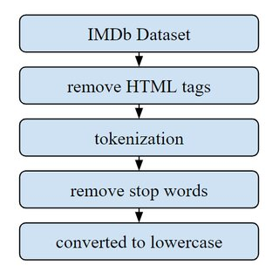
🟦: Preprocessing (IMDB-specific) 🛠️ IMDB-specific Preprocessing: Remove HTML tags 🏷️ Replace contractions (don’t → do not) Handle emoticons 🙂🙁 📊 This helps clean the reviews more effectively.

Slide 9
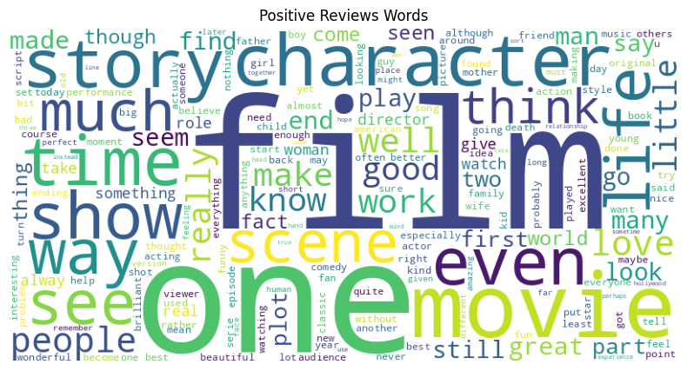
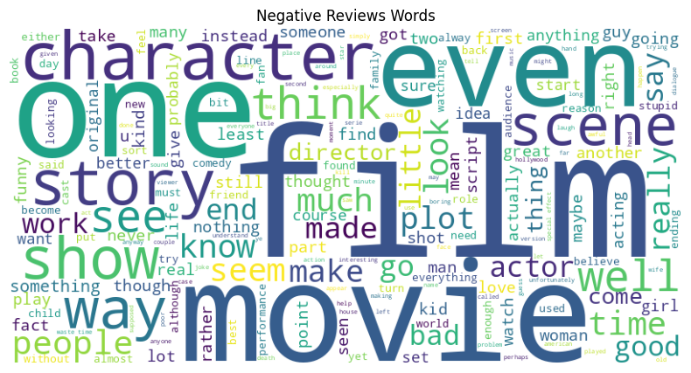

Slide 10
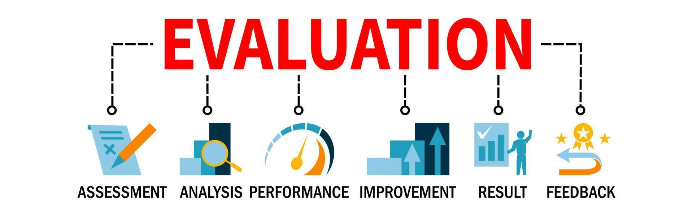
Results & Evaluation
Results & Evaluation
📊 Model Accuracy:
Logistic Regression: ~86% 🚀
🏆 Best Model → Logistic Regression

Slide 11
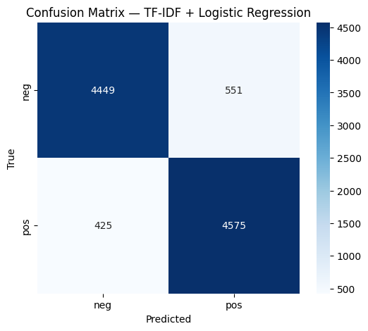

Slide 12

Conclusion
✅ Sentiment analysis helps understand people’s opinions.
✅ Logistic Regression performed the best on IMDB dataset.
✅ Project shows how NLP + ML can analyze movie reviews 🎬

Slide 13


